Slide 1
SBD Cinema Project
Elias Sadek, Ben Phillips, Richard de Young, Daniel Charles Conroy
Notes:
ELIAS

Slide 2
Introduction
-Who are we
-Our approach
-Planning poker
Notes:
ELIAS We are Silent But Deadly and we are a group of fledgling software engineers.
We first approached this project and specification with an open mind and by creating a KanBan board to speak about and communicate user stories and tasks that we may or may not have.
Then after that we used planningpoker.com to give each task/story certain story points that refer to the amount of time/effort the task will take to complete.
Using these values we then separated the tasks out so that we had equal amounts of work to do in reference to the story points.

Slide 3
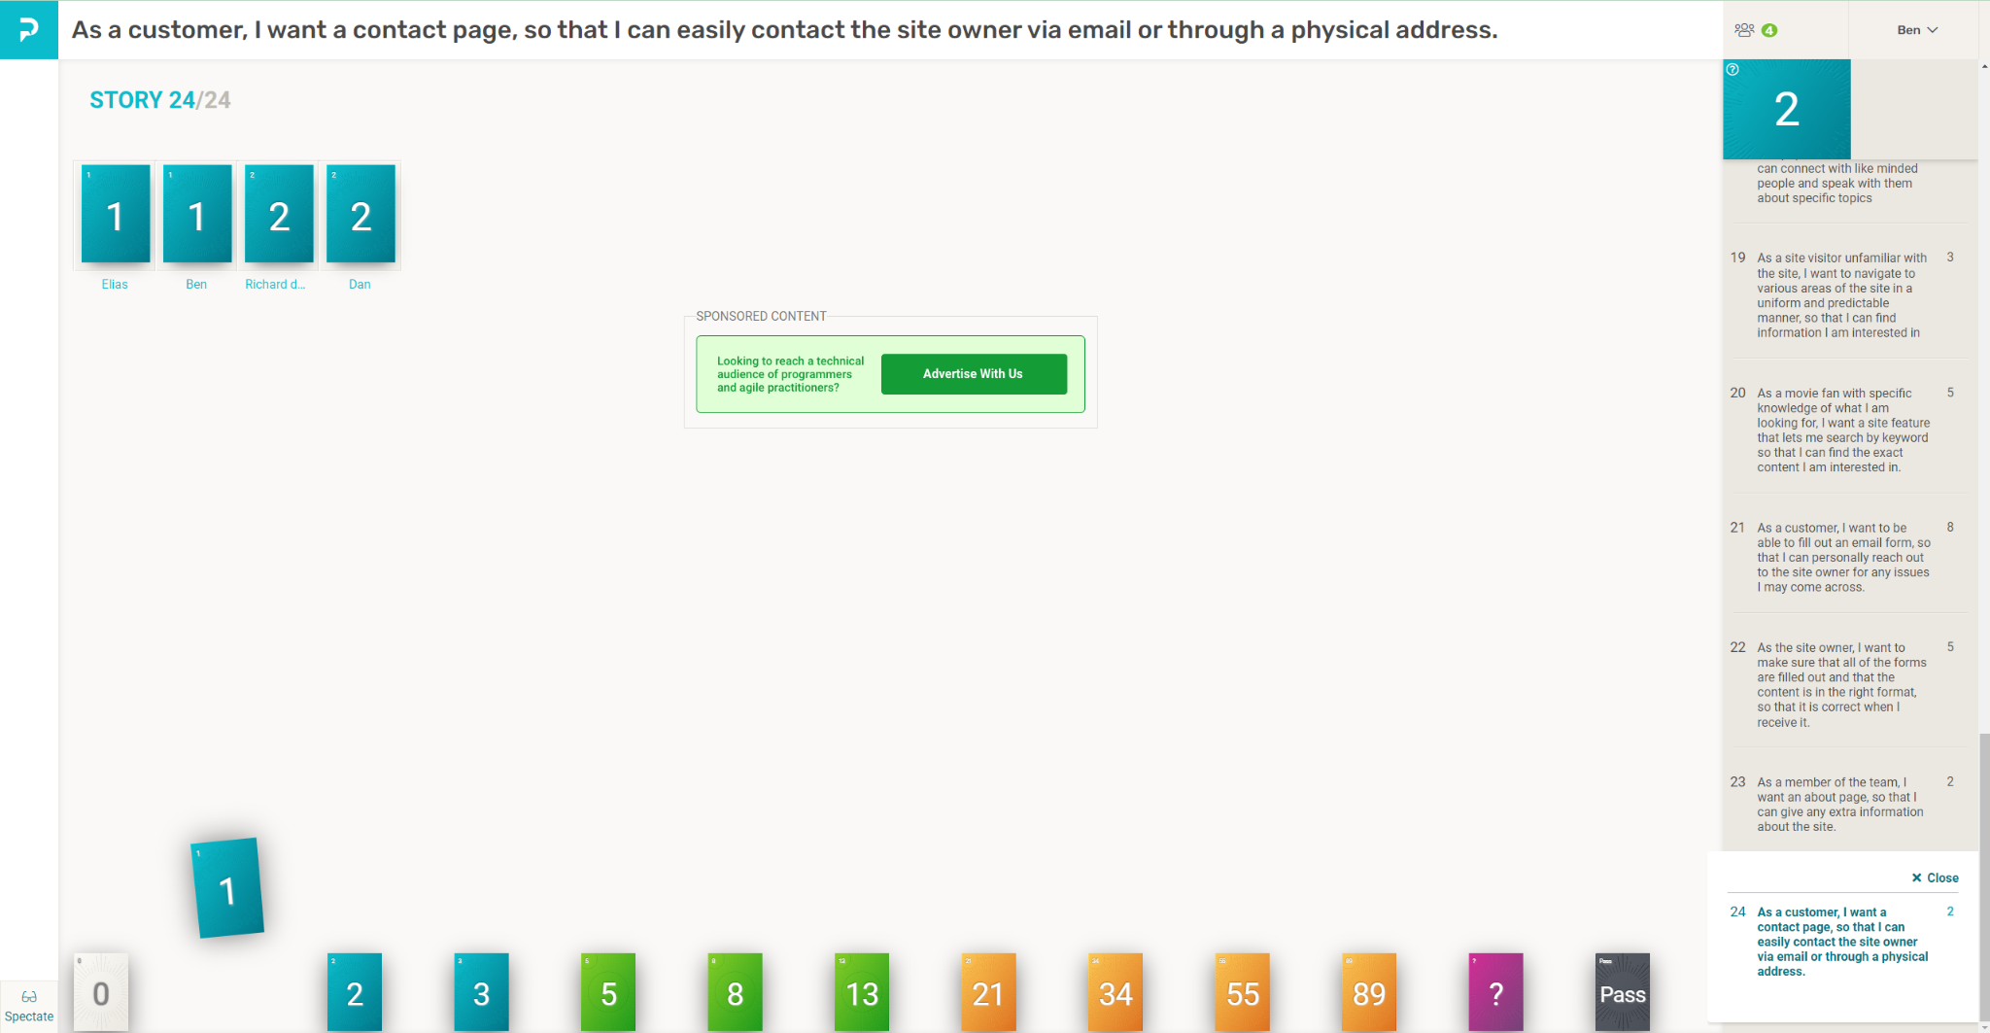
Concept
General Meeting
Jira Kanban board
Story Points
Allocation of tasks
Team problem solving
Team Organisation
Notes:
Scrum Master/Product Owner: BEN -general meeting to discuss what is needed and what should be put onto the board
We mainly focused on getting the mvp story points down first including all of the aspects required for the application.
Then we split different tasks up and allocated them to different team members based on what they felt comfortable with and what they wanted to do.

Slide 4
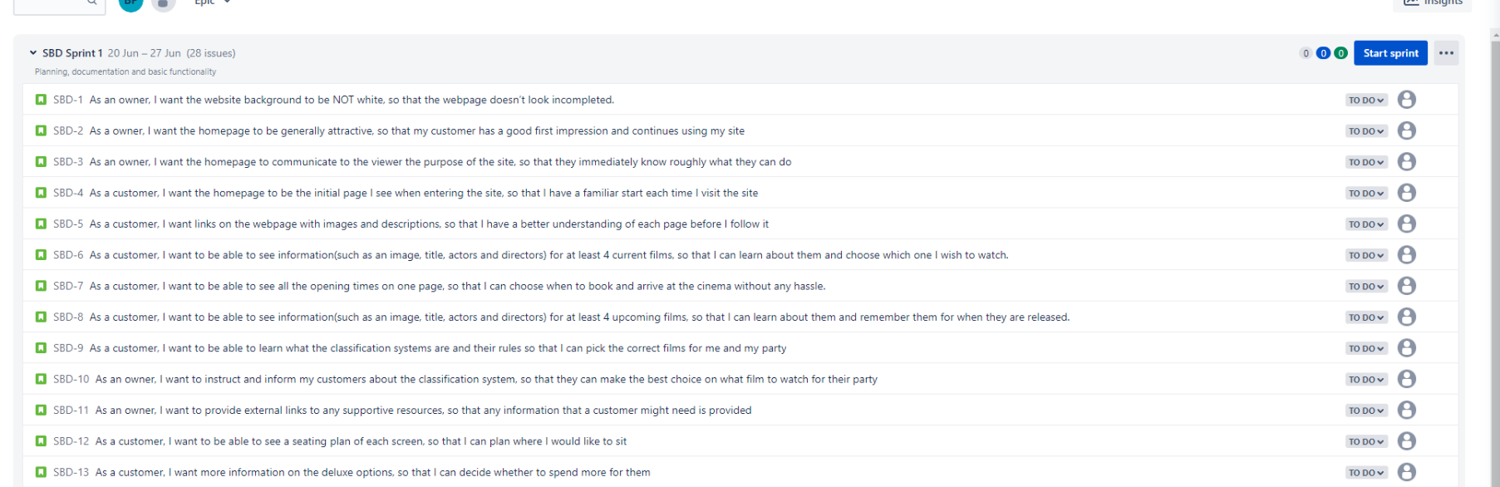
Sprint Plan
-Project length -First sprint -Second sprint -Branches
-Retrospective/review
Notes:
BEN
The project length has been 2 stretches of 5 days leaving enough room for 2 5 day sprints.
The first sprint we focused on building the main plan for the application including building our Kanban board with user stories and issues that we needed to address. Then, using planning poker and user points, we allocated an equal amount of work to all members.
Once we had allocated all tasks, we started by creating all branches we might need on github and starting to write the basic code for each aspect.
We ended each week with a sprint retrospective in which we reviewed our actions for the past week and came up with suggestions for the next sprint.

Slide 5
Consultant Journey
-React
-Mongoose
-NodeJs
-Stripe
-React-Bootstrap
Notes:
ELIAS

Slide 6

CI
-Github branching system
-Dev or Main
Notes:
BEN
We are using the GitHub branching system for our continuous integration. We have created branches for all major pages meaning that if any issues arise, they can be pinpointed and found with more precision.
These branches are all secondary to our development branch, which is where the code is pushed to before pushing it to main. This is to ensure that the main branch is not polluted by ineffective code.

Slide 7
Front-End
-React-Bootstrap
-CSS
Notes:
RICH
React aspects - carousel, navbar

Slide 8
Back-End
Contact Us - Aleksandr Vernin
Payment - Ignacio Aguirre
Mongoose
Notes:
RICH>ELIAS
Email Form - Modified version of code from https://mailtrap.io/blog/react-contact-form/ by Aleksandr Vernin

Slide 9

Testing
-Manual Testing
-Automatic testing
Notes:
ELIAS

Slide 10
Demonstration
Notes:
ELIAS

Slide 11
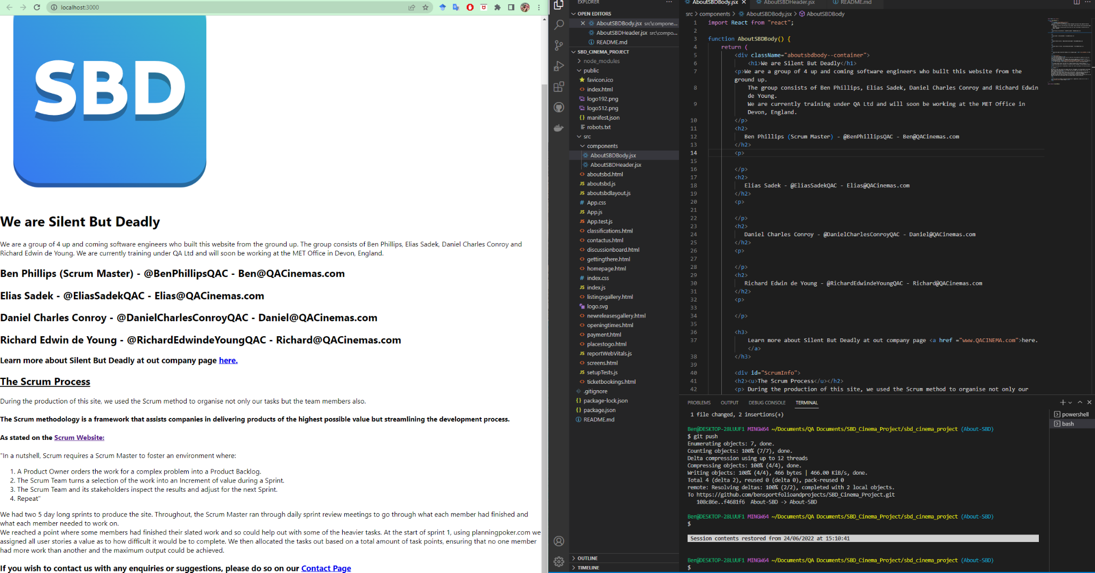
Sprint 1 Retrospective/ Review
-Things that went well
-Things we could have improved on
Notes:
BEN

Slide 12
Sprint 2 Retrospective/ Review
-Things that went well
-Things that could be improved
-Finished?
Notes:
BEN

Slide 13
Conclusion
-Is the application complete?
-Is there anything that was missed?
-Team cohesion
-Stretch goals
Notes:
RICH

Slide 14
Questions?
Notes:
RICH

